Slide 1

Slide 1
Empowering business decisions through online data insights

Slide 2



Slide 5
AGENDA
DATA PREPROCESSING
DATA DRIVEN INSIGHTS
RECOMMENDATION
2

Slide 3
Slide 9
DATA PREPROCESSING
EXTRACTING DATA
DATA LOAD
Tata group online retail data(structured) is extracted from excel spreadsheet for further processing and reporting.
The refined data is loaded into power Bi for further processing and reporting.
2nd
1st
3rd
DATA TRANSFORMATION
Verifying the accuracy of data types assigned to various fields, eliminating missing values and negative balances. Extracting year and month form invoice date and revenue.
3

Slide 4


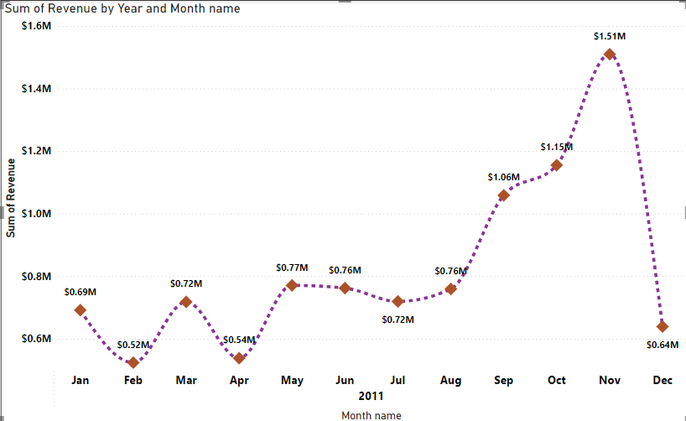
Slide 7
DATA DRIVEN INSIGHTS
Nov 15.3%
A fluctuation in revenue was recorded between Jan and May
November recorded a spike in revenue of USD 1.51million
A drastic fall in revenue was recorded in December with revenue falling from 1.51 million to 0.64 million
Feb 5.3%
4

Slide 5
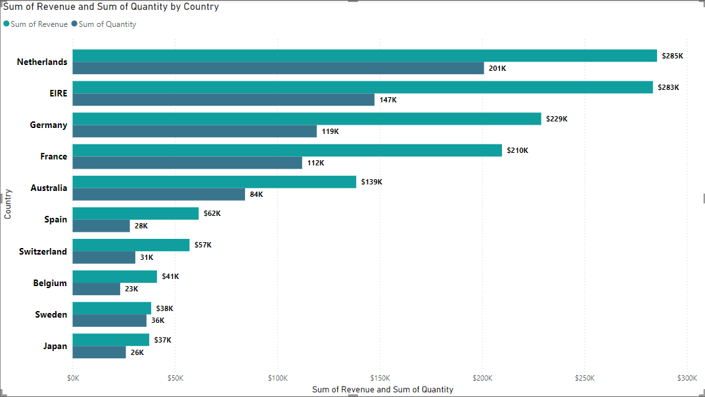
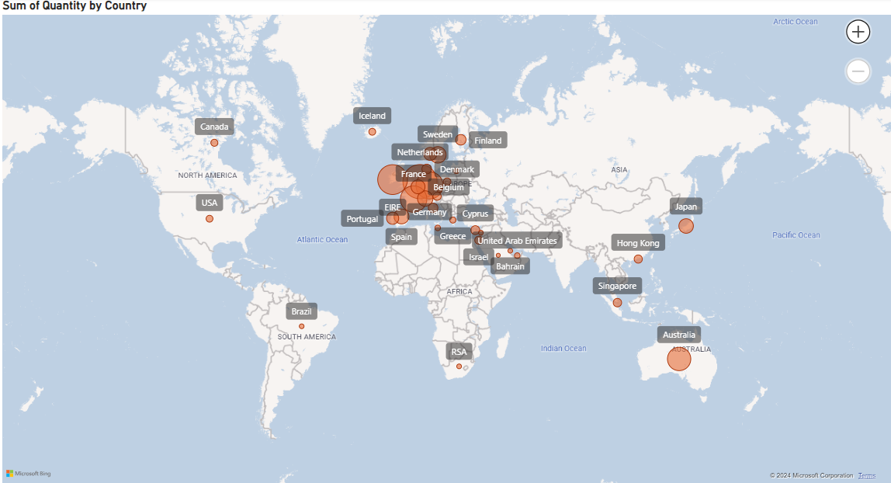
Slide 8
DATA DRIVEN INSIGHTS
Total revenue generated from Netherlands amounted to 285K USD with the least recorded revenue of 37K USD from Japan.
Strong market niche in Europe with potential future market in Asia region.
Netherlands recorded the highest number of quantity sold. Making up 24.9% of total quantity sold globally.
Saudi Arabia recorded the lowest number of quantity sold. Making up 0.01% of total quantity sold.
5

Slide 6

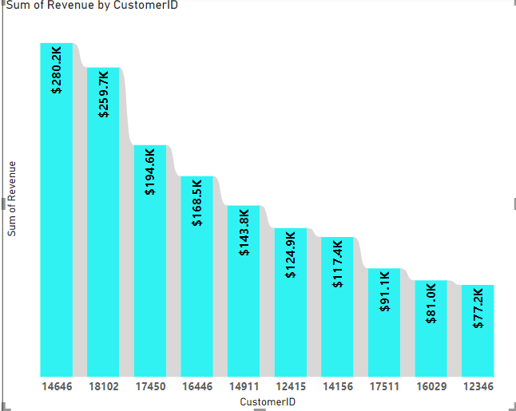
Slide 10
DATA DRIVEN
Customer with ID number 14646 recorded the highest total revenue of 280.2K USD
Target high revenue generating customers
Your logo
6

Slide 7
Slide 6
RECOMMENDATION
Geographical Expansion
Customer Acquisition and Retention
Monetization
Year
Values
Develop strategies to retained and attract more countries form Europe due to Tata’s s strong market presence in this region.
Consider targeting the second most profitable region such as Asia. Analysis revealed a quite number of countries that patronize Tata’s products.
To retain customers, Tata group should consider incentivizing long-term engagement.
Provide quality customer services and shopping experience
Target ideal customers form the Asian region to increase revenue.
Focus on clearing slow-moving stocks with discounts and promotion.
Offer limited time discounts to attract price-sensitive customers
During peak seasons , maximize inventory to meet increased demand.
Train staff and machine learning models to upsell and cross sell.
2018
- 3.567%
2019
+ 1.007%
2020
+ 2.012%
2021
+ 4,031%
7

Slide 8
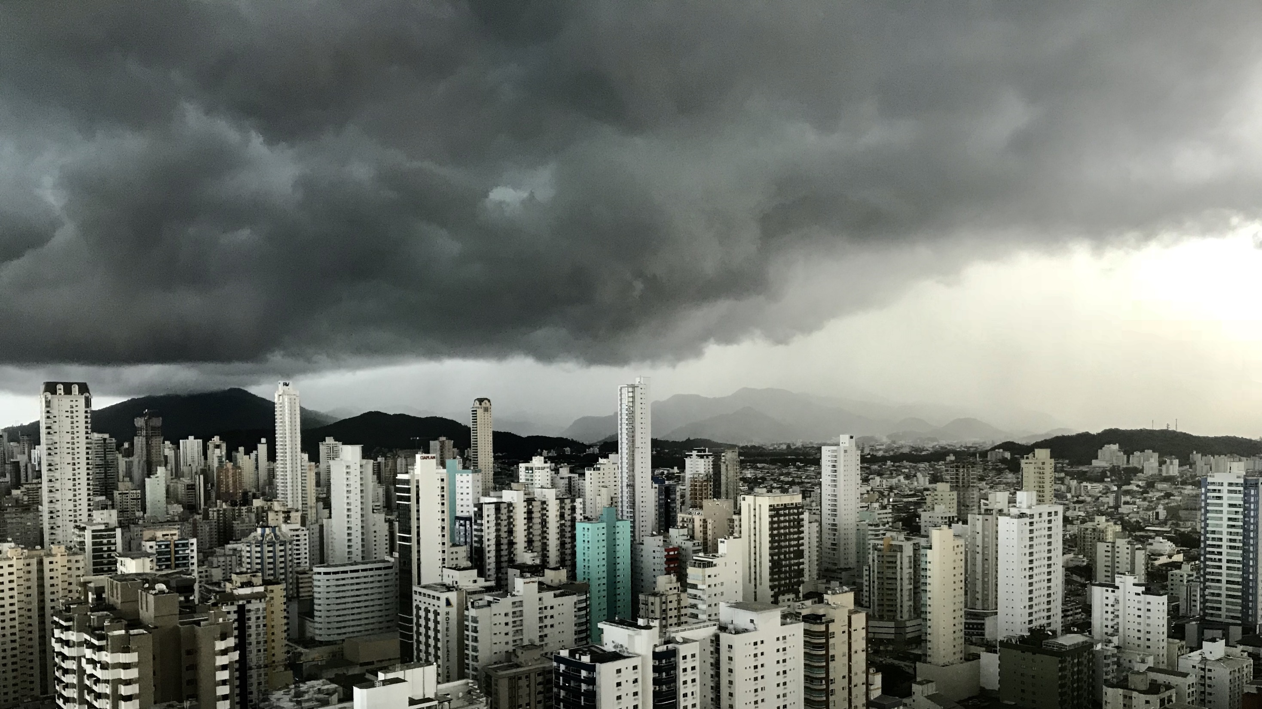
Slide 11
THANK YOU

